Slide 1


Transcendence
October 2024

Slide 2




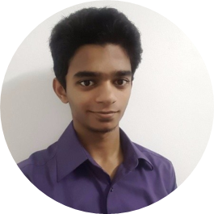
THE TEAM
Joe Shaju
Huong Bui Vu
Jafar Alwaheidi
Zahra Syyida
Shaik Mazin Bokhari
Website design
Setting up Django
Browser compatibility
Tournament
User Friends
ELK Stack
Logging
Microservices
Vault
ModSecurity
Database
User management
Basic Authentication
User Game History
2FA Authentication
Pong Game
Tournament
User Game History
Remote Authentication
JWT Token
Monitoring
Git Review

Slide 3
Introduction
Comprehensive multiplayer Pong game platform
125/125 points compliance with all requirements
Advanced security: JWT, 2FA (TOTP), ModSecurity WAF
Real-time gameplay: 60 FPS server-authoritative sync
Enterprise monitoring: ELK Stack, Prometheus, Grafana
Tournament system with blockchain record-keeping
GDPR compliant user data management
Microservices architecture with Docker deployment

Slide 4
Major Modules
Backend Framework (12/12): Fastify 4.29 + Node.js 18+ + TypeScript 5.3
Database Connection (12/12): SQLite 3 with per-service isolation
Backend Gameplay (12/12): Server-authoritative Pong with physics
Real-Time Sync (12/12): WebSocket 60 FPS game state broadcasting
OAuth & Authentication (12/12): 42 School OAuth + JWT + 2FA (TOTP)
Blockchain Integration (12/12): Hardhat + Solidity for tournament records
Server-Side Rendering (12/12): SSR service for SEO and offline content
Use a Framework as backend
Standard user management, authentication, users across tournaments
Implementing a remote authentication
Implement WAF/ModSecurity with Hardened Configuration and HashiCorp Vault for Secrets Management
Implement Two-Factor Authentication (2FA) and JWT
Infrastructure Setup for Log Management
Designing the Backend as Microservices

Slide 5
Minor Modules
CLI Client (Terminal-based game interface)
AI Opponent (Machine learning-based Pong bot)
Web Application Firewall (ModSecurity + Nginx)
Vault Integration (HashiCorp secrets management)
ELK Logging (Elasticsearch, Logstash, Kibana)
Prometheus Monitoring (Metrics and alerting)
GDPR Compliance (Data export, deletion, consent)
2FA Authentication (TOTP authenticator support)
HTTP-Only Cookies (Secure session management)
Microservices Architecture (4 independent services)
Campaign & Leaderboards (Global rankings system)
Use a front-end framework or toolkit
Use a database for the backend
Monitoring system
Expanding Browser Compatibility
Server-Side Rendering (SSR) Integration

Slide 6
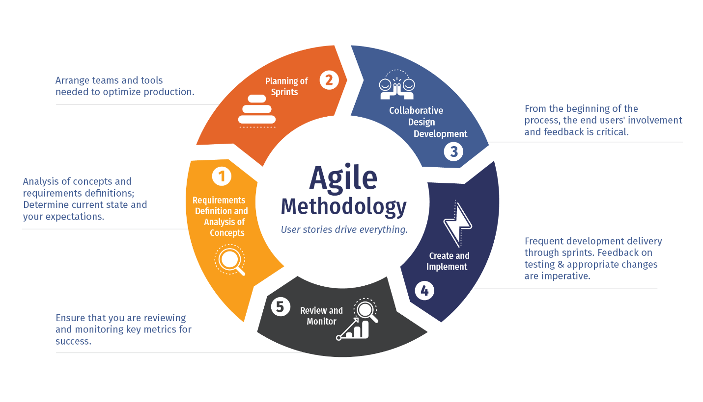
SDLC
Phase 1: Requirements & Planning (Week 1-2) - Define 125 point requirements, architecture design
Phase 2: Core Development (Week 3-7) - Implement auth, game, user services
Phase 3: Advanced Features (Week 8-10) - Add 2FA, blockchain, monitoring, GDPR
Phase 4: Testing & Optimization (Week 11-12) - 180 automated tests, performance tuning
Phase 5: Deployment & Documentation (Week 13) - Docker deployment, final reporting

Slide 7
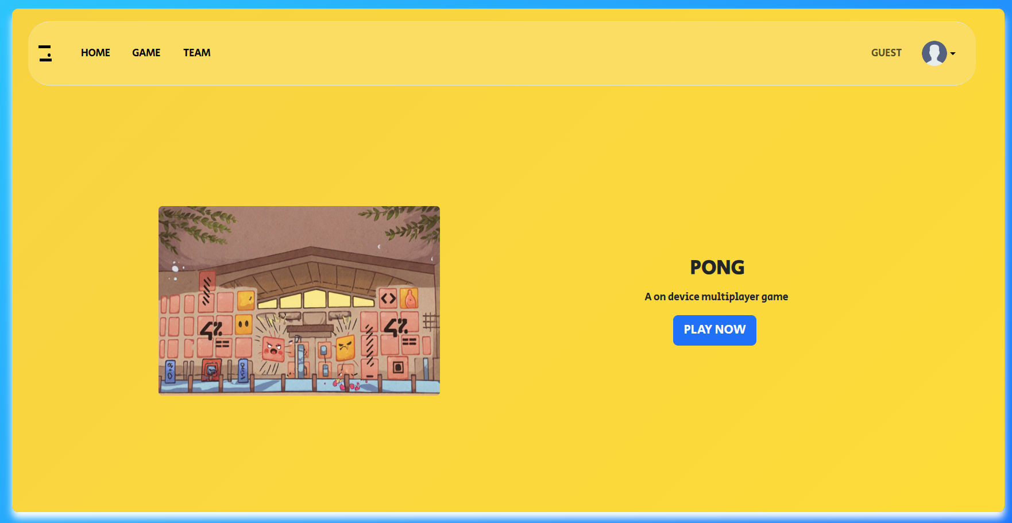
The Site
Notes:
This is our Site, running on Django as the backend and designed atop of bootstrap as the frontend framework

Slide 8
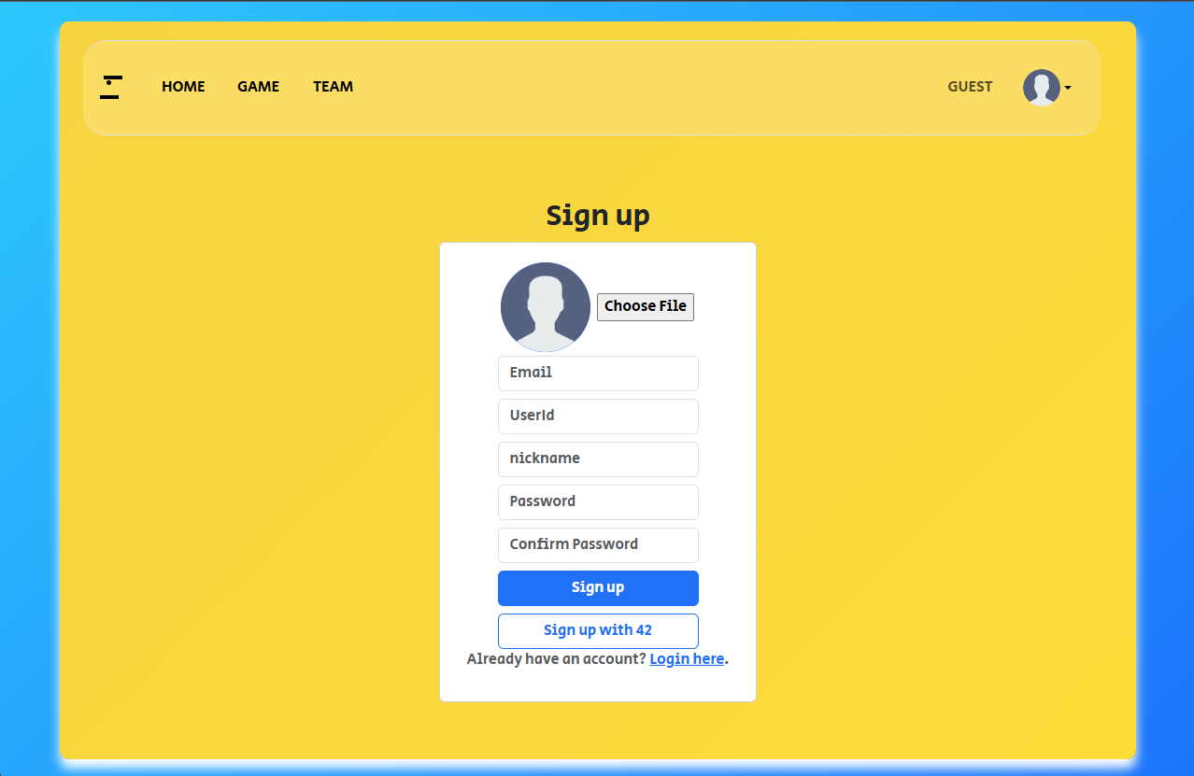
User Management and Registration
Local Registration: Email + secure password (Bcrypt, cost 10)
OAuth 2.0: 42 School intranet integration
Session Management: JWT tokens (HS256, 24h expiry)
User Profiles: Customizable avatars and statistics
Friend System: Add, accept, and manage friend relationships
GDPR Support: Data export and account deletion options
Account Security: Email verification, password reset flow
Notes:
New users can register their accounts by clicking the arrow near the guest icon and pressing sign up.
Add video logging in

Slide 9
Database
Architecture: SQLite per microservice (auth, user, game, tournament)
auth.db: User credentials, sessions, 2FA secrets
users.db: Profiles, friends, statistics, GDPR preferences
games.db: Match history, game events, scores
tournaments.db: Brackets, results, blockchain references
Backup Strategy: Persistent Docker volumes
Encryption: Passwords hashed with Bcrypt, secrets in Vault
Django is connected to PostgresSQL
All user information are stored in the database
All passwords are hashed
2FA keys are encrypted

Slide 10
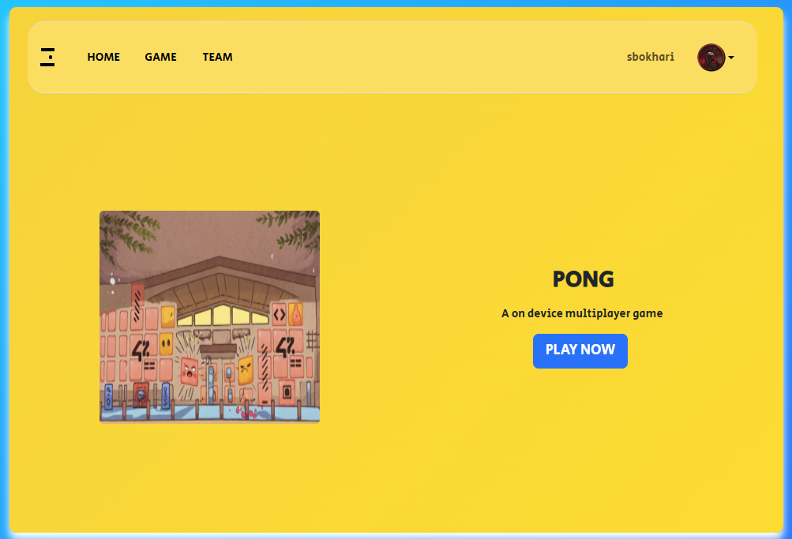
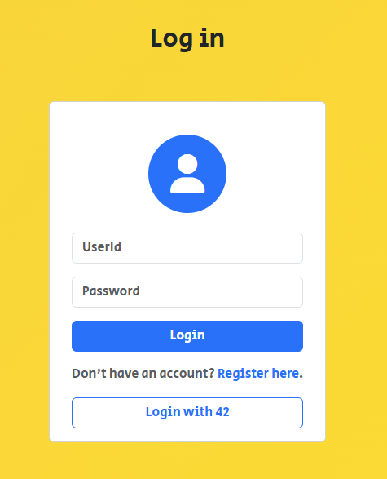
Signing In
Authentication Methods:
Local Login: Email + password validation
OAuth Integration: Seamless 42 School login
Security Features:
Password Hashing: Bcrypt with cost 10
Session Tokens: JWT with 24-hour expiry
Optional 2FA: TOTP authenticator
HTTP-Only Cookies: XSS protection
Notes:
Once the user is registered, they can proceed to the login page and enter their credentials. After which they will be redirected to the home page and are able to confirm they are logged in with their username shown in the top right of the site.

Slide 11
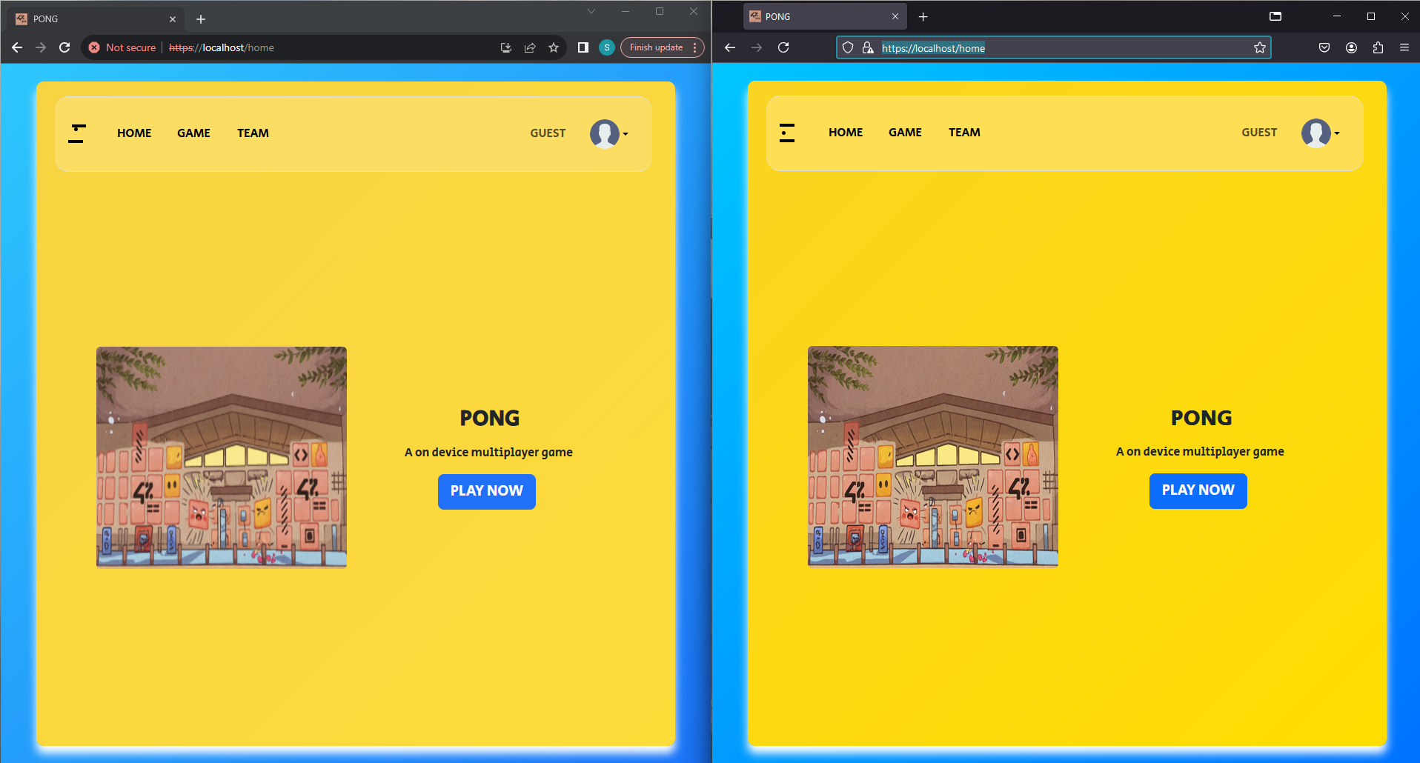

Multiple browser support
Notes:
Being designed on bootstrap, it allows the developer to easily accommodate for support for multiple different browsers. As it can be seen with Chrome and Firefox side by side

Slide 12

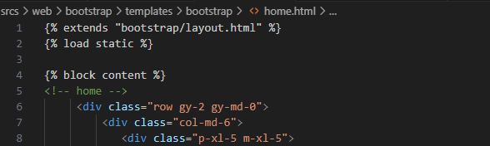
Server-Side Rendering
Purpose: SEO optimization and offline content delivery
Technology: Node.js with template engine
Benefits:
Improved search engine indexing
Faster initial page load
Progressive enhancement support
Reduced client-side processing
Implementation: Dedicated SSR Service (port 3005)
Notes:
Users can seamlessly explore the site without having their system being burdened. By sending the client the segment required for the next page, we are able to reduce load on the client system and network bandwidth resulting in a faster and snappier website experience

Slide 13
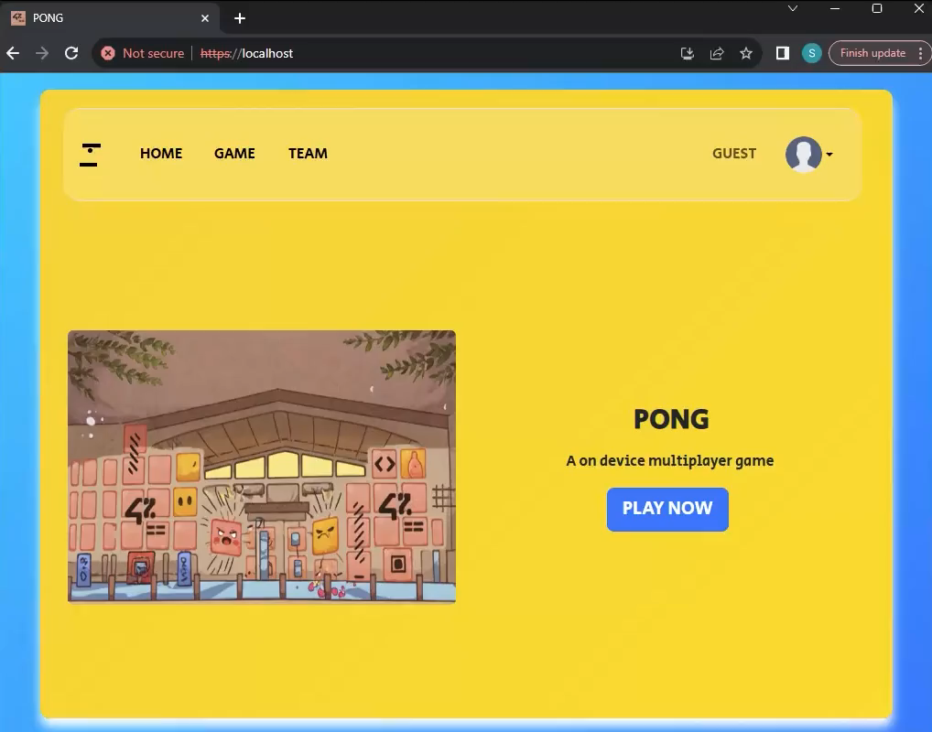
Notes:
Here you can see the user is able to switch between pages seamlessly nor any sign of the browser loading

Slide 14
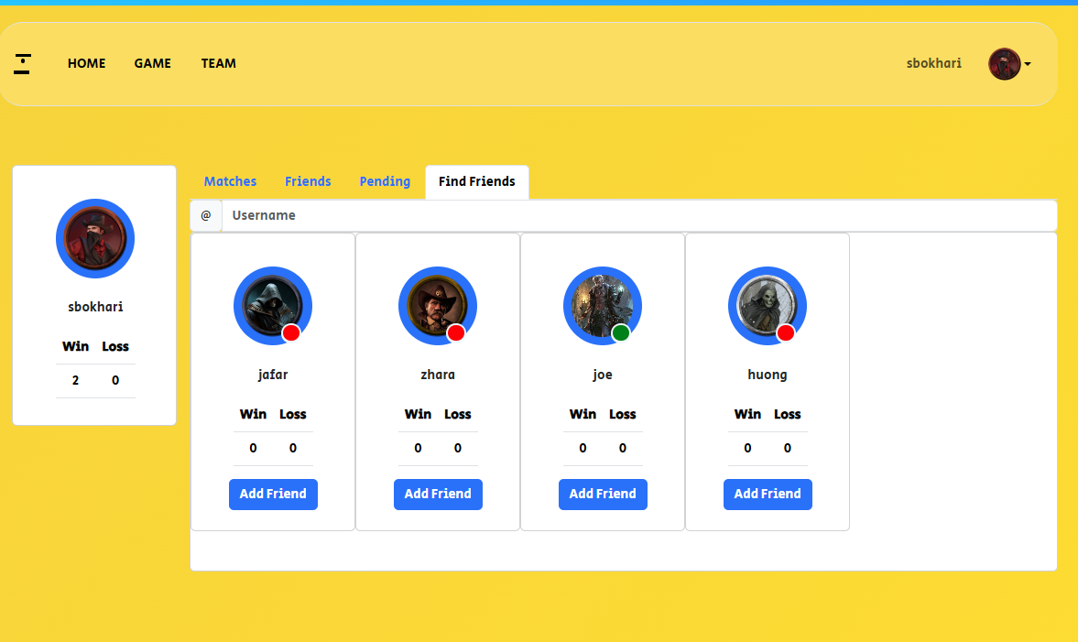
Find Friends

Slide 15
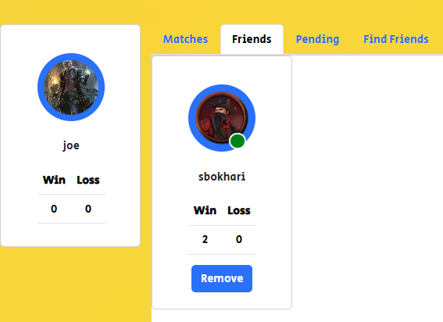
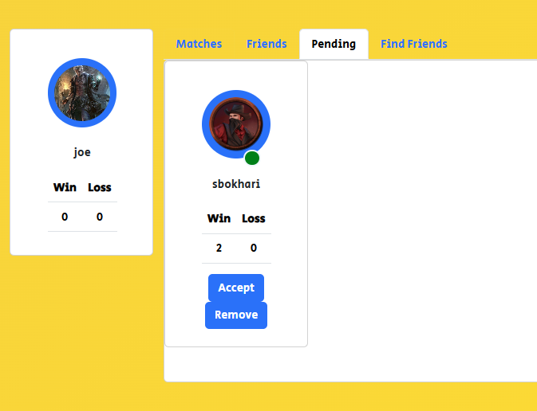
Accepting Friend Request

Slide 16
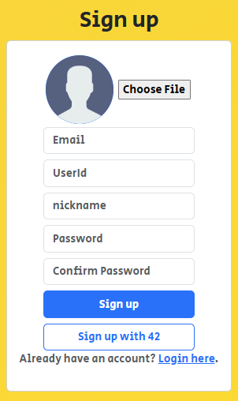
Remote Authetication
Notes:
But that’s not the only way to login, alternatively the user may decide to sign up or login using their 42 account. Upon clicking it

Slide 17
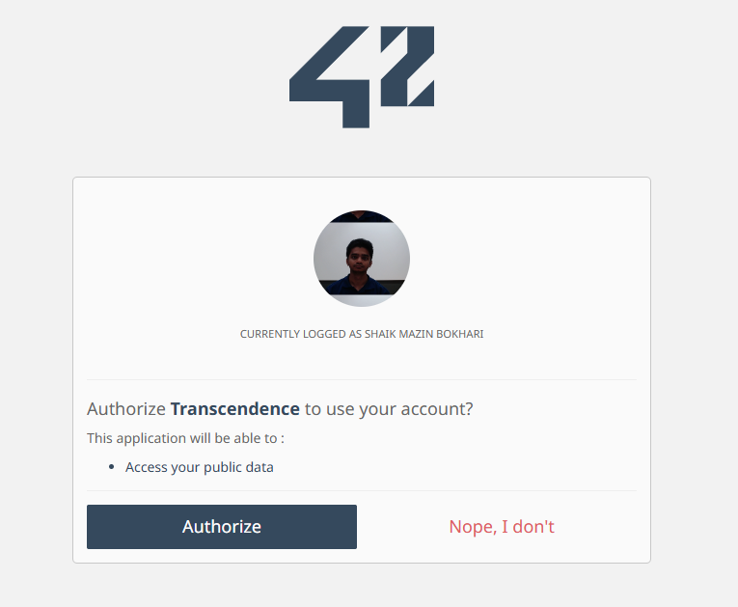
42 auth image
Notes:
The user will redirected to the 42 site. If already logged in, they will asked to authorize the site and will be redirected back to our site.

Slide 18
JSON Web Tokens
Log in to receive a refresh token
Private resources are secured using JSON Web token
All unauthorized access are denied or redirected to home

Slide 19
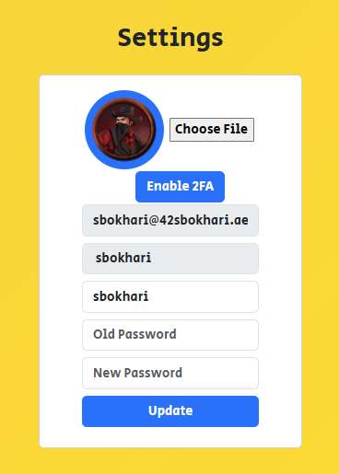
User Settings
Notes:
- Users can manage their profiles through settings.
- Key features:
- Upload avatar: Personalize profile with an image.
- Change password: Secure access by updating credentials.
- Add a nickname: Customize display name for games and interactions.
- Enable Two-Factor Authentication (2FA): Enhance security.

Slide 20
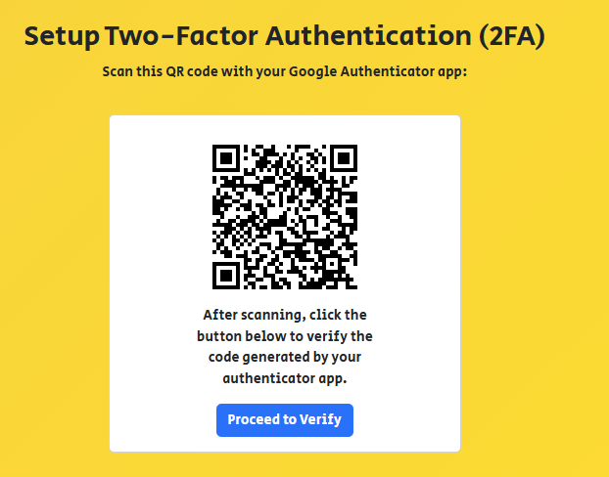
2 Factor Authentication
Notes:
Upon choosing to enable 2FA, the user is redirected to the setup page where they are asked to scan the QR code.

Slide 21
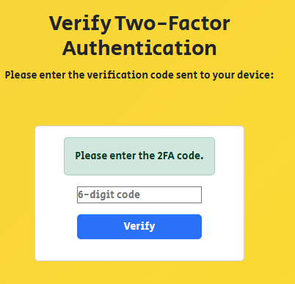
Notes:
Upon successfully verifying the code from an authenticator app the 2FA authentication will be enabled for the user. Where upon their next login will be required to enter 2FA to complete the login process

Slide 22
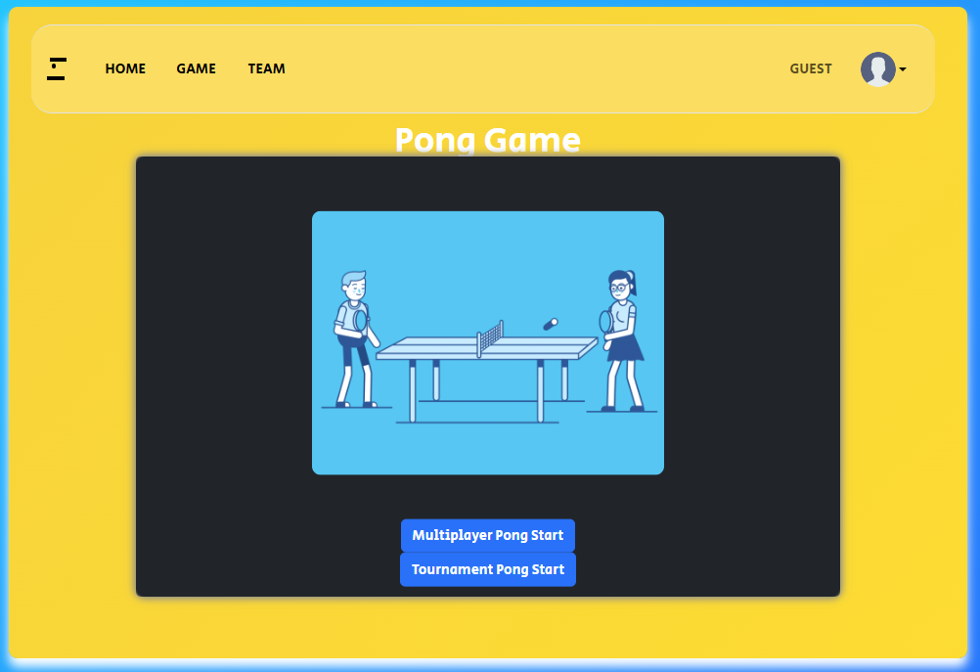
Pong
Game Mechanics:
2-player Pong: Real-time multiplayer
Server-Authoritative: No client-side cheating
60 FPS Synchronization: 16.67ms per frame
Physics Engine: Ball trajectory and collisions
Features:
WebSocket communication for low latency
Automatic disconnection handling
Match statistics tracking
Replay capability (optional)
Notes:
Users can access the pong game and start with two different options

Slide 23
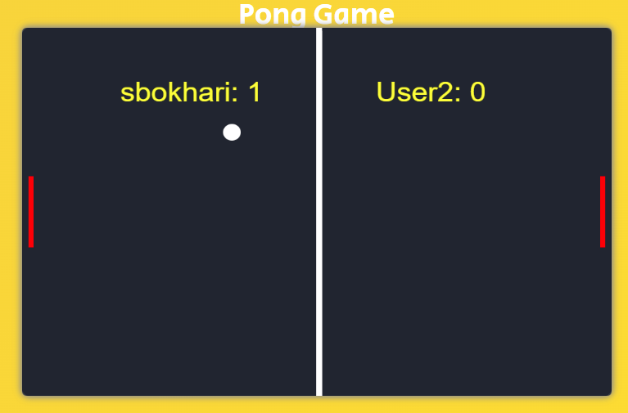
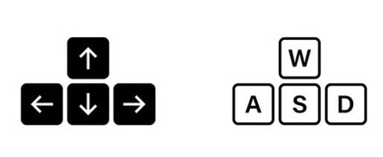
Multiplayer mode
Notes:
- Two-player game controls:
- User 1: Uses WASD keys.
- User 2: Uses arrow keys.

Slide 24
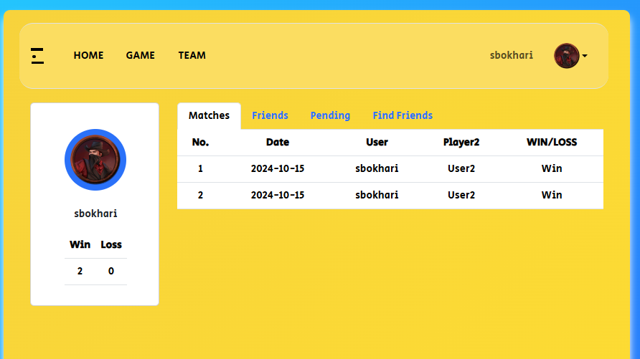
Match History
Notes:
Displayes wins and losses by date as well as total wins and losses.

Slide 25
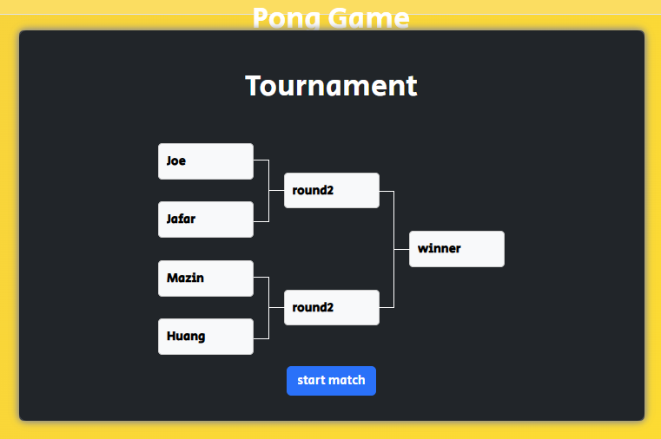
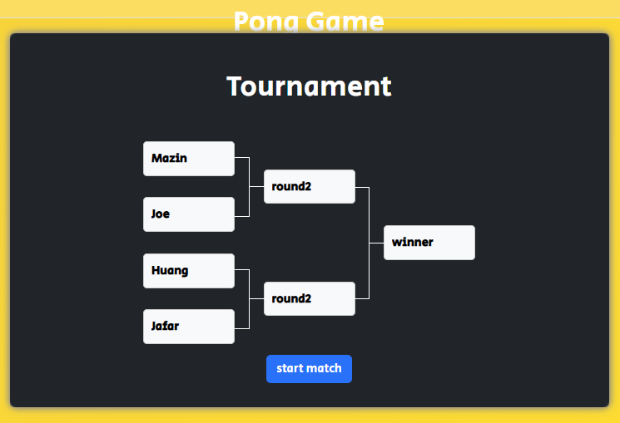
Tournament
Tournament System:
Single/Double elimination bracket
Automatic match scheduling
Real-time score updates
Advanced Features:
Blockchain recording of final results
Smart contract for tournament integrity
Leaderboard rankings
Prize/reward system integration
Notes:
- Bracket system for organizing matches:
- after inputting Player aliases: Displays nicknames.
- after Randomization: Shuffle player positions in the bracket for fairness in matchmaking.

Slide 26
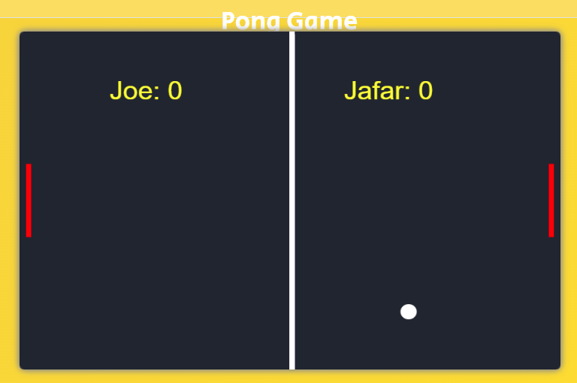
The Matches
Notes:
Each match continues till one player gets 10 points and then the winner of that match is displayed in the brackets

Slide 27
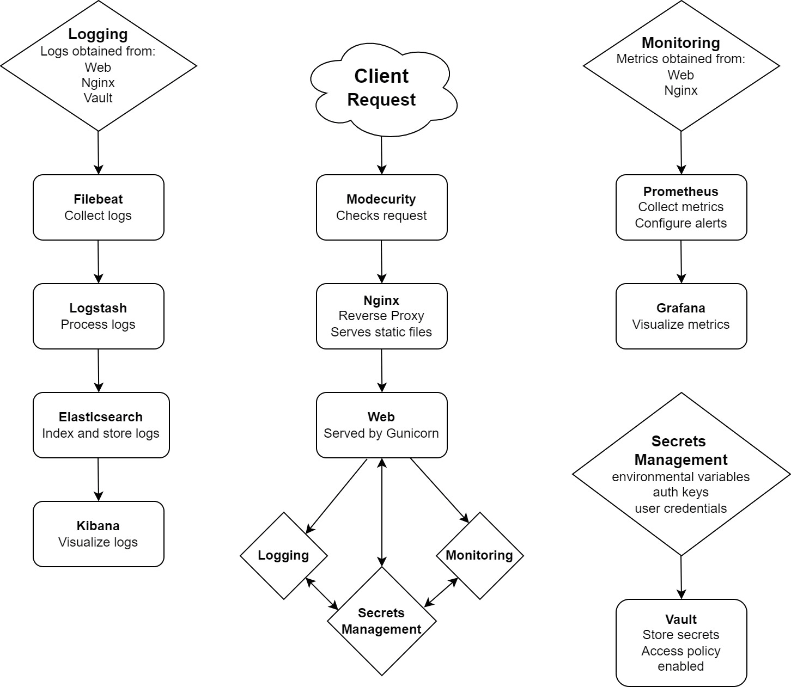
Logging and Monitoring
Logging Stack (ELK):
Elasticsearch: Central log storage
Logstash: Log parsing and enrichment
Kibana: Dashboard visualization
Monitoring Stack:
Prometheus: Metrics collection
Grafana: Dashboard and alerts
Custom metrics: API latency, game events, user actions

Slide 28
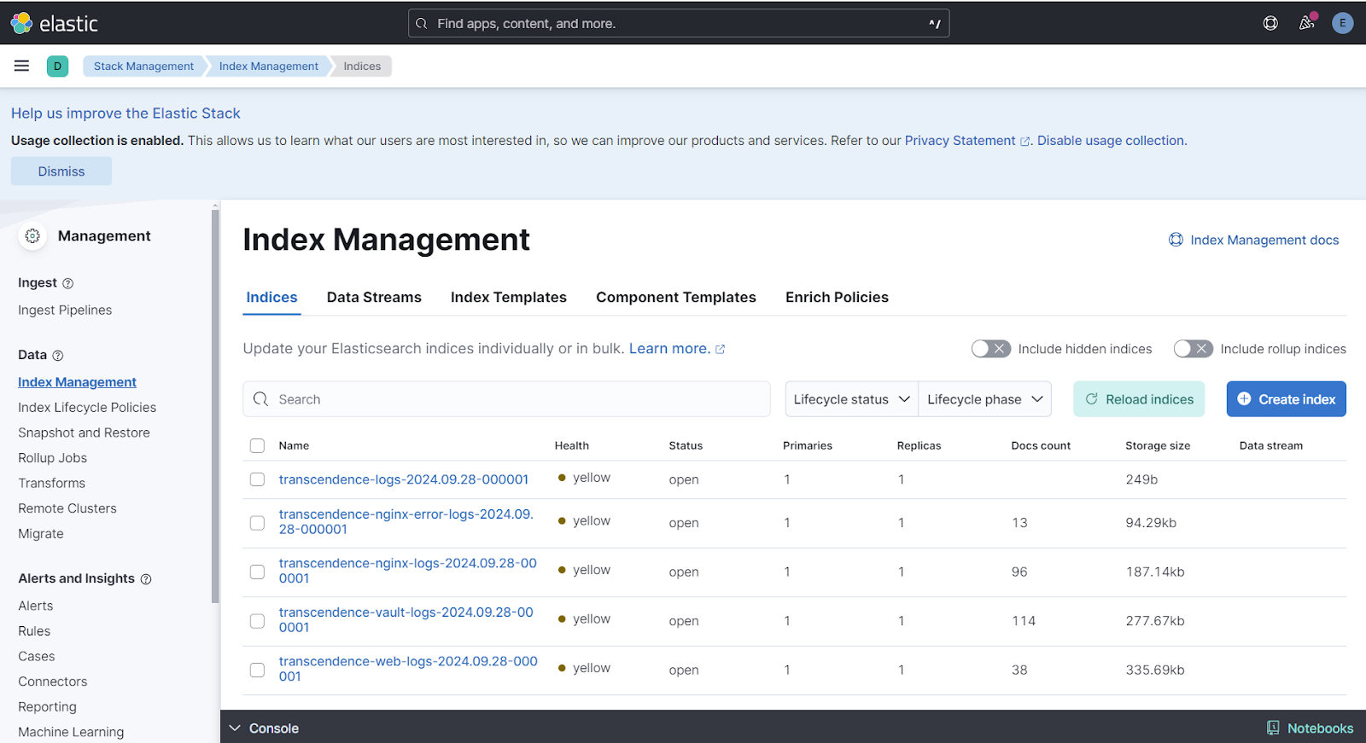
Logging

Slide 29
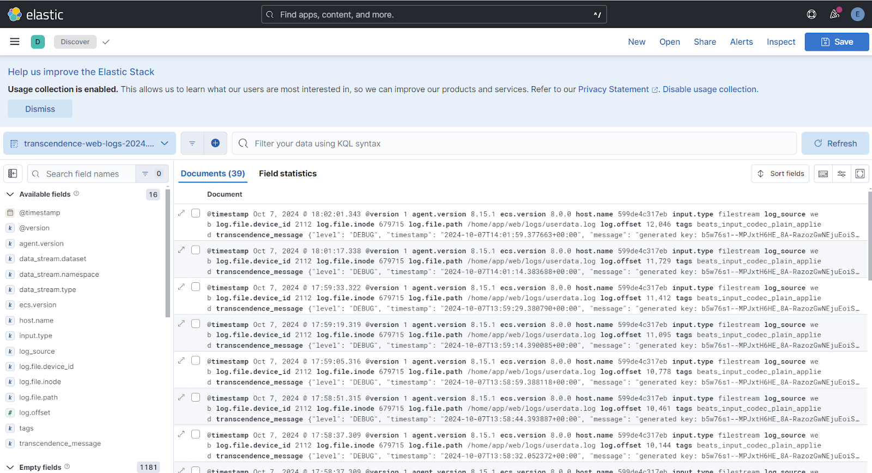

Slide 30
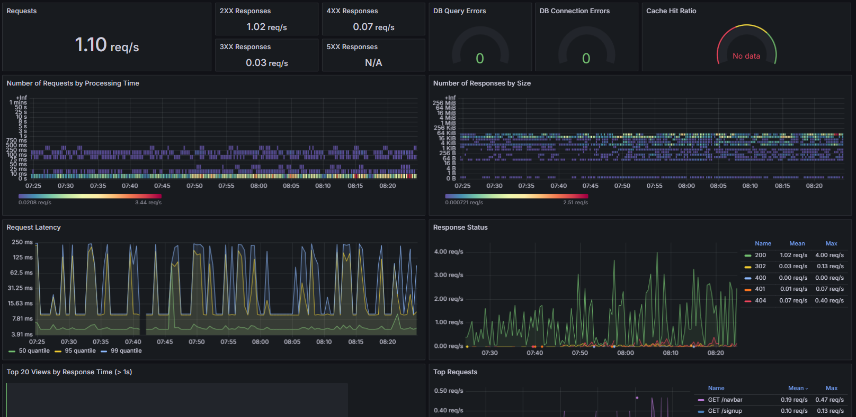
Monitoring

Slide 31
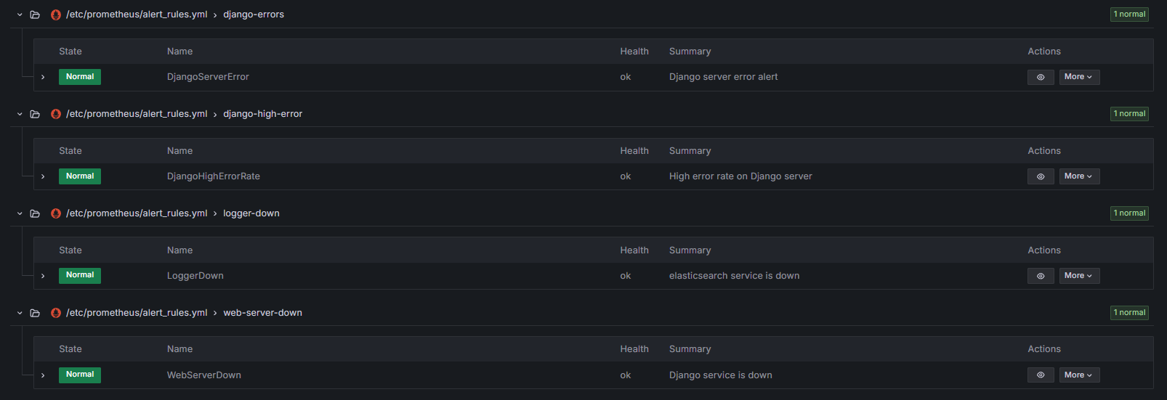
Alerts

Slide 32

Security
Network Layer:
Nginx reverse proxy (ports 80, 443)
TLS 1.2+ encryption
ModSecurity WAF protection
Application Layer:
JWT authentication (HS256)
Bcrypt password hashing
CSRF protection (SameSite cookies)
Parameterized SQL queries
XSS prevention (CSP headers)
Data Protection:
Vault secrets management
Database encryption at rest
HTTP-Only cookies
Site access using nginx as reverse proxy
Nginx is integrated with Modsecurity
Secret keys, encryption key, credentials stored in Vault
Notes:
The site is accessed through nginx, integrated with mod security to safeguard the server. Vital keys required for the operation of the sites and other services are stored in the vault to maximize protection and cant be access without prior unsealing.

Slide 33
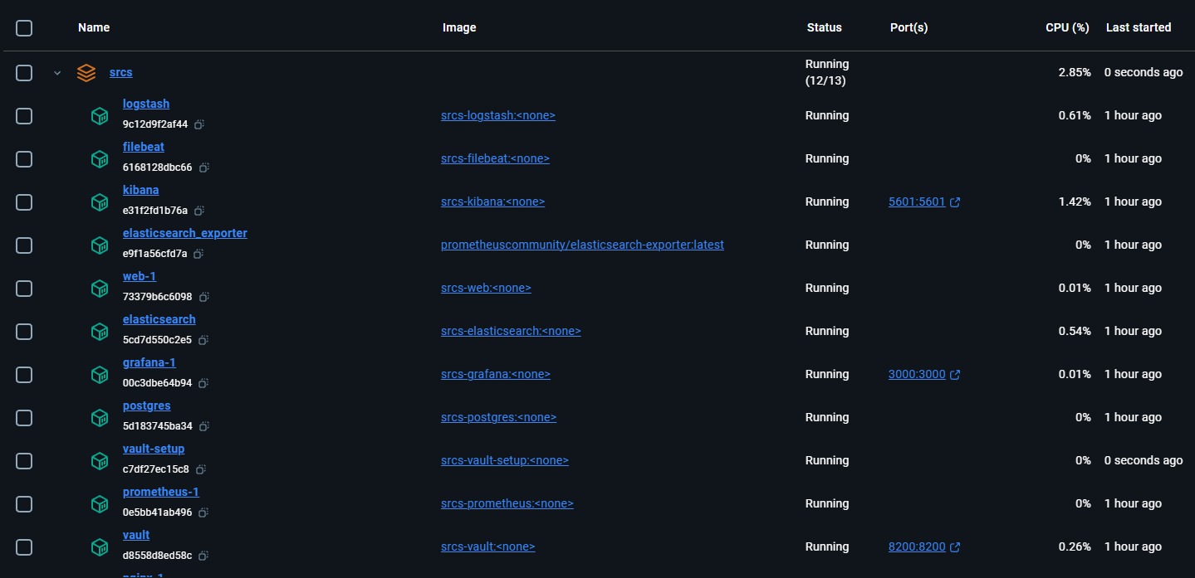
Microservices
Service Architecture:
Auth Service (port 3001): User authentication & sessions
User Service (port 3002): Profiles & social features
Game Service (port 3003): Pong gameplay & real-time
Tournament Service (port 3004): Brackets & blockchain
SSR Service (port 3005): Server-side rendering
Benefits:
Independent scaling per service
Technology flexibility
Fault isolation
Continuous deployment capability
Notes:
We separated each of our services from into different containers. This allowed us to collaborate more easily while also increasing the overall reliability of the entire site while also increasing the security.

Slide 34
Limitations
Single-game: Only Pong implemented
Max players: 2 per match
Browser compatibility: Modern browsers only
Regional deployment: Single server instance
Blockchain: Ropsten testnet (demo only)
Storage: SQLite (not production-scale)
Real-time: ~50ms latency minimum
Lack of online gameplay support
Tournaments are limited to 4 players
Game cannot be played on mobile device
Lack of AI Pong opponent
Users are unable to chat with each other
Notes:
Add performance limitations?

Slide 35
Future Improvements
Additional games: Chess, Connect 4, others
Mobile app: Native iOS/Android clients
Database scaling: PostgreSQL cluster
Global deployment: Multi-region infrastructure
Mainnet blockchain: Production smart contracts
AI improvements: Advanced bot algorithms
Payment integration: In-game purchases
Video streaming: Match replay system
Online support to the game
Customizable Speed
Chat functionality
More Alert triggers
Means to send Alerts to admins
Cloud Vault unsealing
Better Animation

Slide 36
Thank you

